Slide 1
Computing with Minecraft 3: Parks and recreation

Slide 2
Lesson 1: Code a park fence

Slide 3
What we’ll learn
To use loops in coding
To change the default inventory slot
To create a park in our Minecraft city

Slide 4
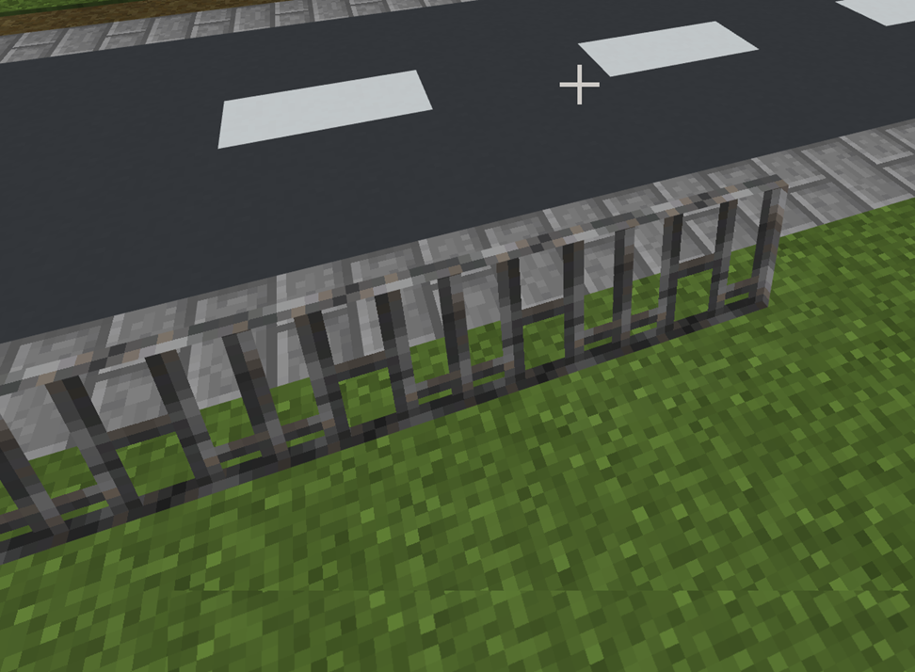
Code with loops
Make sure your player position is 67, 69, -557
Teach your Agent to build a fence around the park

Slide 5
Let’s discuss
What’s a benefit of using LOOP blocks in coding?
When the Agent uses stuff from it’s inventory, which slot is the default?
LOOPS

Slide 6
Lesson 1 Let’s review
What did you learn today that you didn’t know before?
What was most challenging?
What questions do you have?

Slide 7
Next time
Code a water fountain in the park

Slide 8
Lesson 2: Code a water feature

Slide 9
What We’ll learn
To code your Agent to build a water fountain

Slide 10
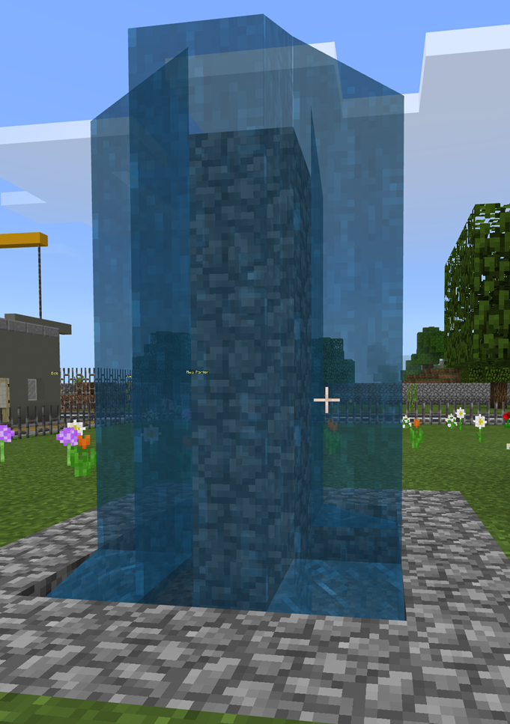
Let’s code
Give your Agent inventory
Dig the fountain boundary
Fill with Cobblestone
Dig inside the fountain
Code the water feature
Add the water

Slide 11
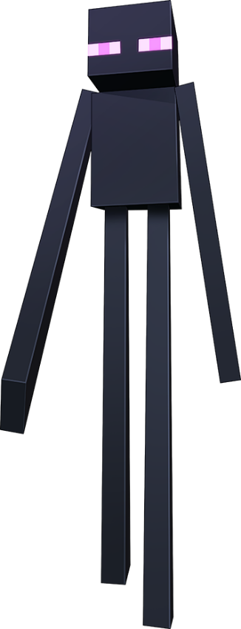
Let’s discuss
How do you change the slot the Agent pulls from their inventory?

Slide 12
Lesson 2 Let’s review
What did you learn today that you didn’t know before?
What was most challenging?
What questions do you have?

Slide 13
Next time
Add flowers to your park

Slide 14
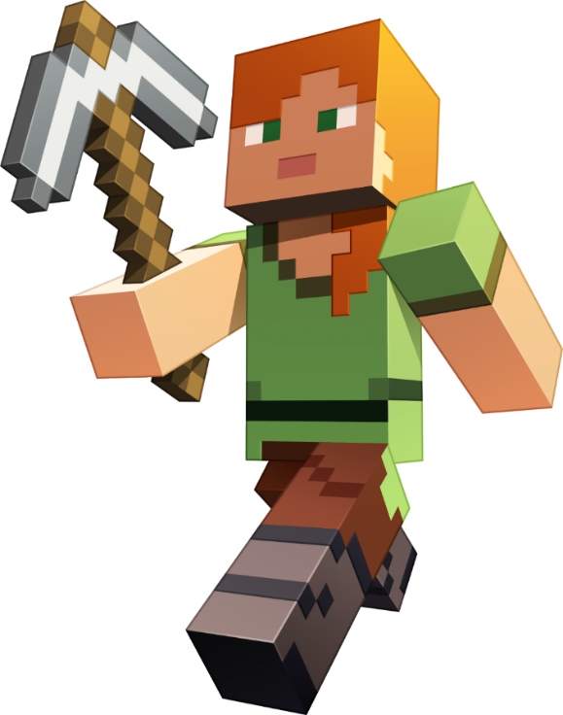
Lesson 3 : Plant some flowers

Slide 15
What we’ll learn
To use blocks in the math drawer to randomly plant flowers in the park
MATH

Slide 16
Let’s add plants
Give your Agent an inventory
Code to randomly pull inventory
Code your Agent randomly move
Position your Agent and run the code

Slide 17
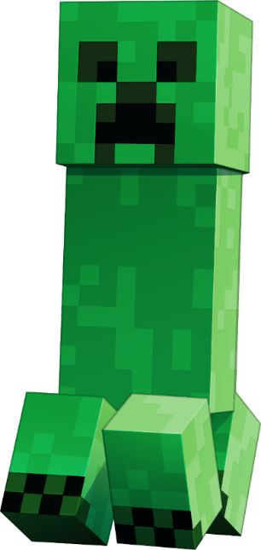
Let’s discuss
What are two ways we used the coding block?

Slide 18
Lesson 3: Let’s review
What did you learn today that you didn’t know before?
What was most challenging?
What questions do you have?

Slide 19
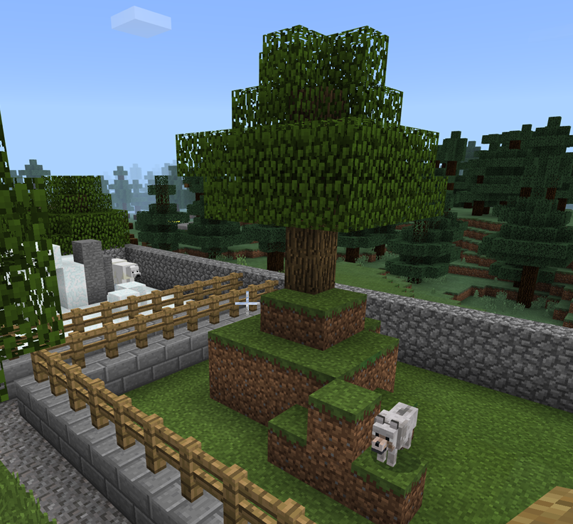
Next time
Add a zoo to your city

Slide 20
Extension Activity 1
Code different seasons.
Show the park in winter and summer weather.

Slide 21
Extension Activity 2
Animate the water fountain.
Use the fill or place code features.

Slide 22
Extension Activity 3
Design and code a park statue or art sculpture to add to your park.

Slide 23
Extension Activity 4
Code a park event for the appointment of a mayor, city marathon, or a festival.

