Slide 1
Coding with Minecraft 9: Artificial intelligence

Slide 2
Lesson A: Introduction to artificial intelligence

Slide 3
What we’ll learn
What artificial intelligence (AI) is and its value
The criteria to classify computers as intelligent
To create intelligent rules for a game

Slide 4
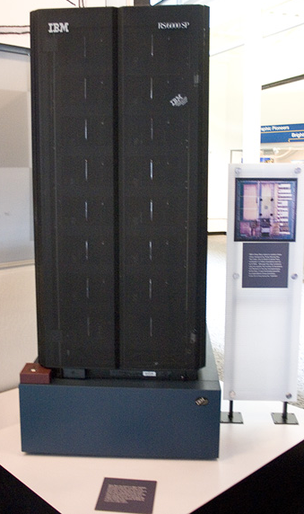
What is artificial intelligence?
Intelligence demonstrated by machines
Example: IBM Deep Blue, the first intelligent computer to beat a human at chess
Photo source: Jim Gardner at flickr.com/photos/jamesthephotographer/

Slide 5
Let’s play a game: Paper ai
Play tic-tac-toe
Create intelligent rules
Test the rules

Slide 6
Let’s discuss
What is artificial intelligence?
What’s one reason to classify a computer as intelligent?
If a computer is intelligent, does that mean it has consciousness, self-awareness, or feelings?

Slide 7
LESSON A What we learned today
Defined artificial intelligence and its importance
Discussed criteria to classify machines as intelligent
Created intelligent rules to play tic-tac-toe

Slide 8
Next time
Code a maze in Minecraft!

Slide 9
Lesson B: Explore intelligent code

Slide 10
What We’ll learn
Explore and build on a maze generation program

Slide 11
Coding a maze
Read an existing program and answer these questions:
What does the fill block do?
Why do we place a block of Air at ~0 ~0 ~0?
Why do you think we set agent destroy obstacles to false?
What is the difference between the two Teleport commands?

Slide 12
Maze pseudocode
Shuffle the array:
Create an array of three directions
Randomize their order
For each value in the array:
If it's left,
turn left
If it's right,
turn right
If there's a wall in front of us (empty on the other side),
preserve the wall
If there's no wall in front of us,
dig a path forward (recursively by calling the same function "dig" again)
Back up 2 spaces
Turn back to original direction

Slide 13
Let’s discuss
Describe what the fill block does.
Why do we Place a block of Air at ~0 ~0 ~0?
Why do you think we set agent destroy obstacles to false?
What is the difference between the two Teleport commands?

Slide 14
Lesson B What we learned today
Explored a maze program and added more code to it

Slide 15
Next time
Code an intelligent agent to navigate a maze

Slide 16
Lesson C : Code an intelligent agent

Slide 17
What we’ll learn
Learn a maze-following algorithm
Teach the agent to intelligently navigate a maze

Slide 18
Coding an intelligent agent
Use a maze-following algorithm and conditionals to teach the agent to find it’s way through any maze
As long as you aren't standing on redstone:
If there is no block to the left of you,
turn left and move forward.
Otherwise, if there is no block in front of you,
move forward.
Otherwise, if there is no block to the right of you,
turn right and move forward.
Otherwise,
turn around and move forward.

Slide 19
Let’s discuss
If you were in a maze in real-life, what’s a strategy to find your way out?
If your agent is in a maze in Minecraft, what are the key steps to find its way out?

Slide 20
Lesson C What we learned today
An algorithm to find our way out of a maze
How to code the algorithm so our agent could intelligently navigate any maze

Slide 21
Next time
Code a tree hunting agent
Take a short quiz

Slide 22
Lesson D : Code a tree hunting agent

Slide 23
What we’ll learn
Code our agent to find and chop down trees
Check our learning progress with a quiz

Slide 24
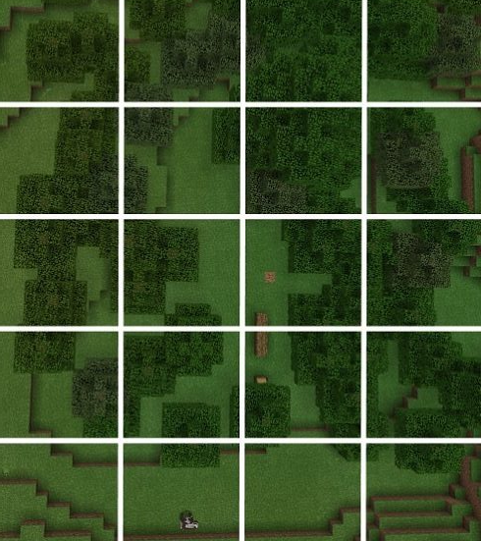
Coding a tree hunting agent
How will the agent approach the task?
What about changing elevation and terrain?
How will it chop down the trees? (no problem!)

Slide 25
Lesson D What we learned today
Coded an intelligent, tree-chopping agent
Took a quiz

Slide 26
Next time
Your independent project
Think about other tasks an intelligent
agent could do for you

Slide 27
Lesson E: Get creative with artificial intelligence

Slide 28
What we’ll learn
Code a project to teach the agent or builder to intelligently adapt to Minecraft

Slide 29
Paired independent project
Work with a partner
Automate a task in Minecraft
Code the agent or builder to intelligently adapt to the Minecraft environment

Slide 30
Ideas to consider
Finding temples
Finding villages
Finding dungeons
Harvesting mature wheat
Harvesting tall sugar canes
Finding the way out of a cave
Building a road but navigating the landscape

Slide 31
Example pseudocode for finding jungle temples
Create a variable for steps
Create a variable for turns
Teleport the Builder to my position
Ascend to 20 blocks above my position
While a test for moss stone in an area between 20 and 15 blocks below the Builder is negative:
Change the number of steps by 1
If the number of steps is greater than the search area:
Alternate turning right or left based on the value of turns
Reset steps to zero
Flip the value of turns (i.e., if it’s true, make it false, and vice versa.)
Move forward to search a new area
If you have found moss stone,
report your current position since moss stone above ground level is the likely spot of a jungle temple.

Slide 32
Minecraft Diary entry
What Minecraft problem did you decide to solve? What does your program do?
Describe how your AI figures out how to perform the task or solve the problem
Discuss one (or more) ways that working with a partner was different from just doing the project by yourself.
Describe one point where you got stuck. Then discuss how you figured it out.
Share your project to the web and include the URL.

Slide 33
Lesson E What we learned today
Coded your agent to intelligently do a task in Minecraft

Slide 34
Next time
Review everything you’ve
learned
Start your final project

