Slide 1
Coding with Minecraft 7: Iteration

Slide 2
Lesson A: Introduction to iteration

Slide 3
What we’ll learn
What iteration is
The purpose of iteration in coding
Get to know your Agent and teach him to dance

Slide 4
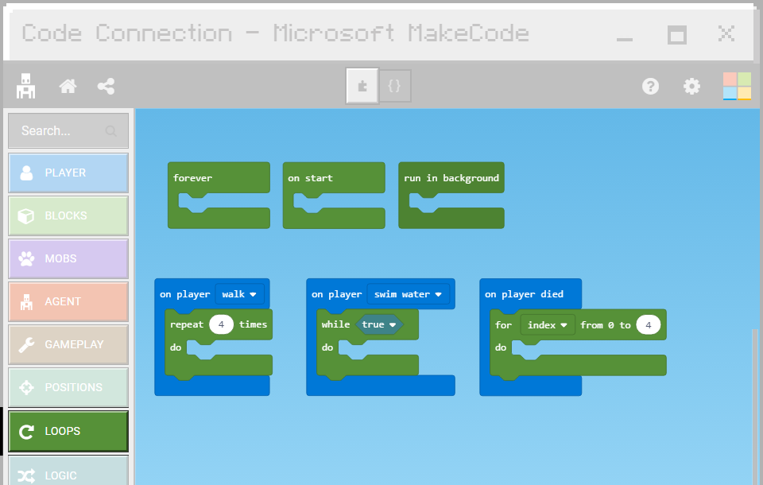
What is iteration?
When you want to do the same thing many times
Code that tells a computer to REPEAT sets of instructions under different conditions
Different types of loops do different things

Slide 5
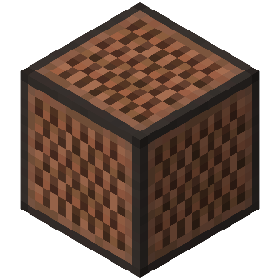
Other words for repeat
Loop
Iteration
Iterate
Iterative
Repetition
Repetitive
What are some real-life examples of things you would repeat?

Slide 6
Walking is iteration…
.----.
| |
| v
| Step 1 - "left foot forward"
| |
| v
| Step 2 - "right foot forward"
| |
| v
'- REPEAT
Repeating an action in a loop!
What are other examples in your daily life?

Slide 7
Let’s play a game: Walk around the house
Pretend an object is a house in Minecraft
Write instructions to walk around the house, using these two commands:
forward()
turn left/right()

Slide 8
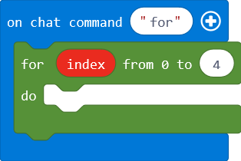
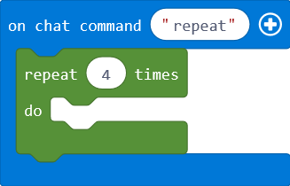
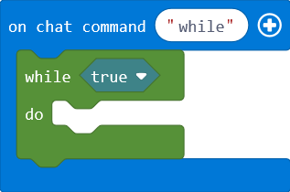
Types of loops in Makecode
Counted loops
Repeat n times
For index 0 to n
While (true) loops
Forever loops

Slide 9
Let’s discuss
What’s another word for iteration?
What are two ways that loops are beneficial when coding?

Slide 10
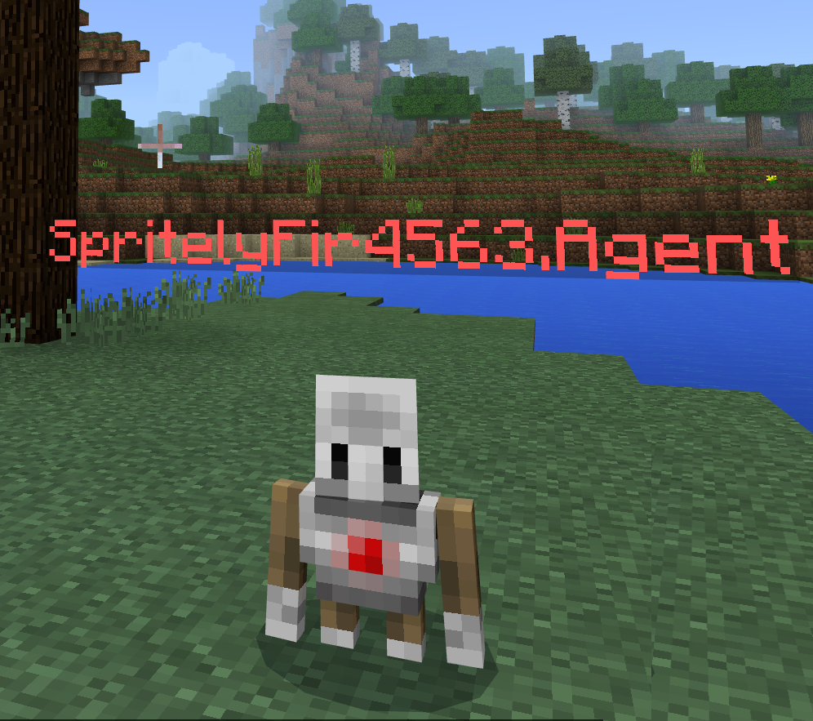
Code with loops
Get to know your agent
Code it to move, turn, and more

Slide 11
An agent with dance moves
Use loops to teach your agent to dance

Slide 12
Let’s discuss
Are agent commands based on coordinates or the direction the agent faces?
How do you turn on the Slo-Mo feature in MakeCode?

Slide 13
Lesson A What we learned today
What iteration is, other words for it, and the benefits in coding
Different types of loop blocks in Microsoft MakeCode
Got to know your agent
Used loops to code your agent to dance

Slide 14
Next time
Use loops to code our agent to build a tower

Slide 15
Lesson B: Coding with Iteration

Slide 16
What We’ll learn
Look for iteration in everyday tasks
Code our agent to build a tower

Slide 17
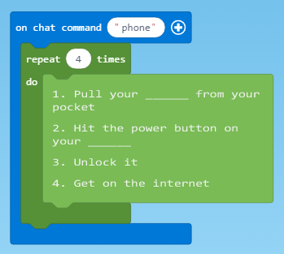
What’s the task?
Steps:
Pull your __ from your pocket.
Press the power button on your __.
Unlock it.
Get onto the internet.
Code:

Slide 18
One block at a time
Code our agent to build a tower with a loop
Easily monitor each pass through the loop
for

Slide 19
Let’s discuss
When an agent places blocks, which corner of his inventory is used?
How do you see your agent’s inventory?

Slide 20
Lesson B What we learned today
Found example of iteration in everyday tasks
Coded with loops to get our agent to build a tower

Slide 21
Next time
Teach our agent to farm
Fix broken code with loops
Take a short quiz

Slide 22
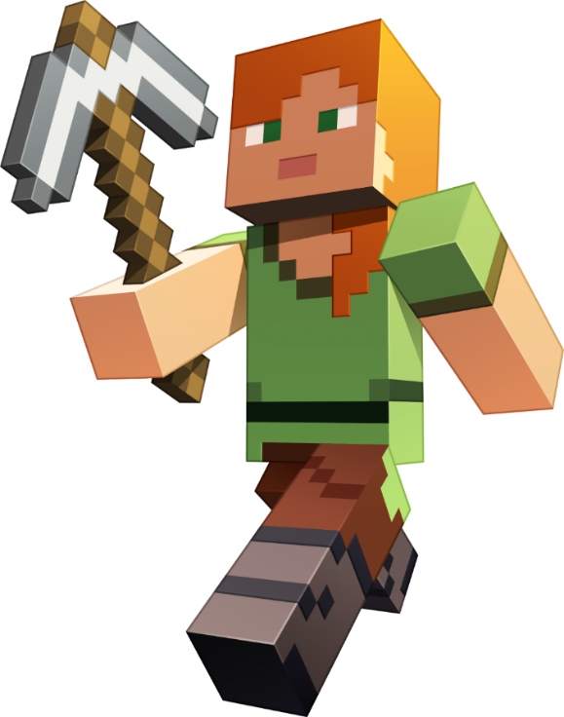
L C : Debugging with iteration

Slide 23
What we’ll learn
Code our agent to till soil
Fix broken code
Check our learning progress with a quiz

Slide 24
Help your agent farm
Teach it to till soil
Fix broken code

Slide 25
Lesson C What we learned today
Used loops to code our agent to farm and fixed broken code
Took a quiz

Slide 26
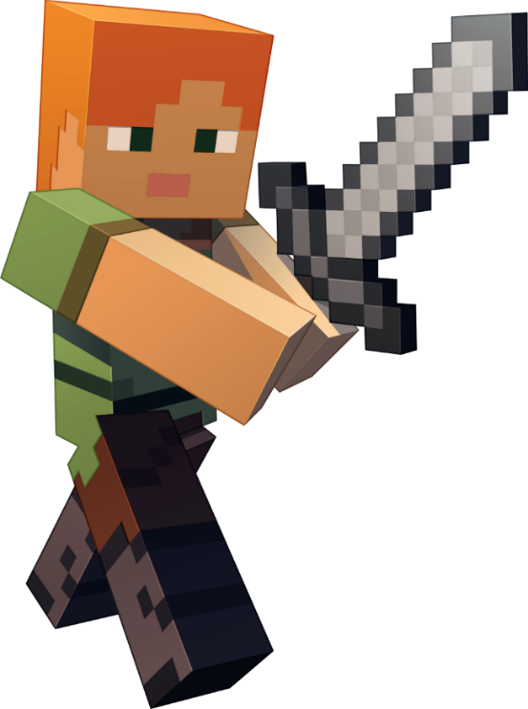
Next time
Your independent project

Slide 27
Lesson D : Get creative with iteration

Slide 28
What we’ll learn
Code a project to find diamonds underground using a staircase

Slide 29
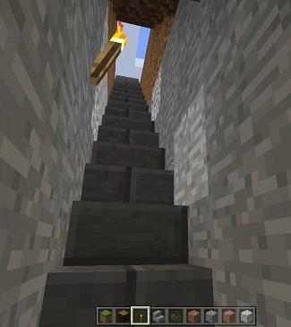
Independent Project
Challenge yourself:
Look at code you don’t understand for ideas
Copy and paste code, then make it your own
Think of other ideas not mentioned in the lessons
Take an abstract goal and code to accomplish it
Show what you know!

Slide 30
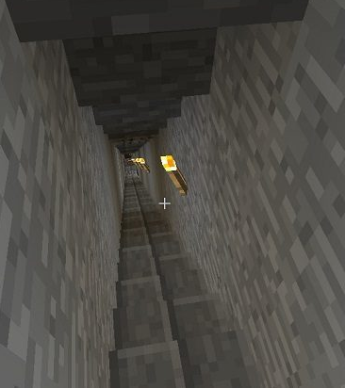
Option 1: Straight staircase
Most common type
Allows you to run up and down quickly

Slide 31
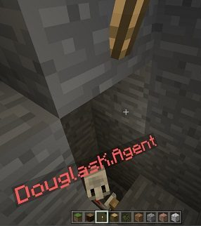
Option 2: Spiral staircase
Another type of staircase
Similar code as a straight staircase, with turns added

Slide 32
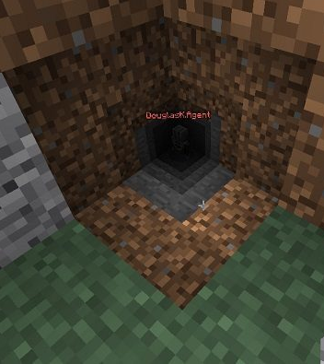
Option 3: Diagonal tunnel
A “staircase” at a diagonal angle
Remove layers of blocks in a specific order

Slide 33
Minecraft Diary entry
What type of staircase did you choose to build: Straight, Spiral, or Diagonal? Why?
What problems did you encounter? How did you solve them?
How did you use loops in your staircase?
Describe one point where you got stuck. Then discuss how you figured it out.
Include at least one screenshot of your staircase.
Share your project to the web and include the URL.

Slide 34
Lesson D What we learned today
Applied our new coding skills with loops to create a staircase to diamonds

Slide 35
Next time
Learn about arrays
How to code with them

