Slide 1
Coding with Minecraft 4: Variables

Slide 2
LESSON A : Introduction to Variables

Slide 3
What we’ll learn
The importance of variables
The different kinds of variables
To code a game in Minecraft with variables

Slide 4
Types of variables
Number variable – This holds numeric data.
Examples: a person’s age, a player’s score, the year
String variable – This holds a string of alphanumeric characters.
Examples: a person’s name, a password, the day of the week
Boolean variable – This has only two possible values: true or false.
Examples: Is it daytime? Is the game over?
Position variable in MakeCode – A special kind of variable that holds three numbers that describe a specific location in three-dimensional space.

Slide 5
Slap, Clap, Snap
There are three types of variables:
Slap Player slaps their thighs or their desk
Clap Player claps their hands
Snap Player snaps their fingers

Slide 6
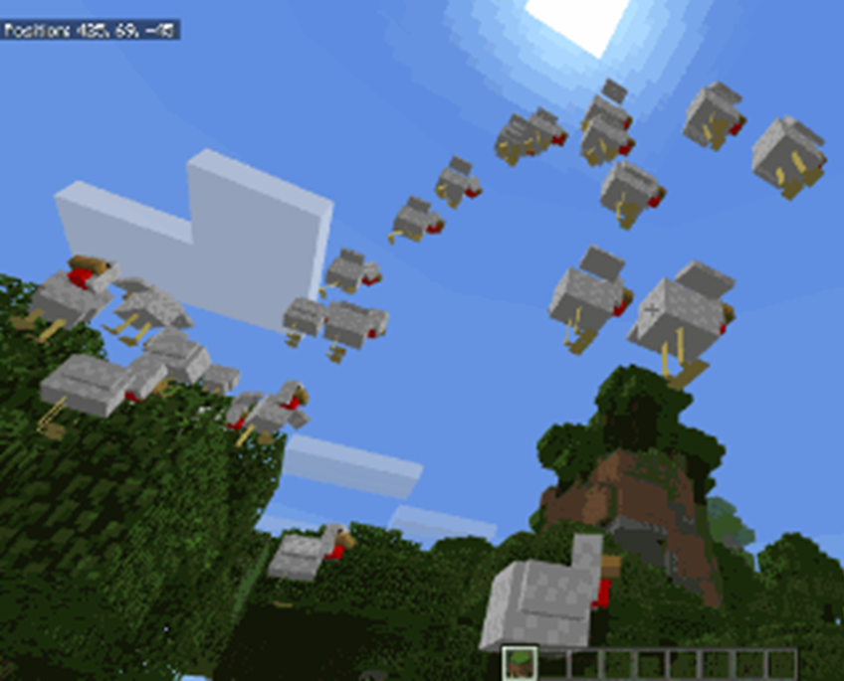
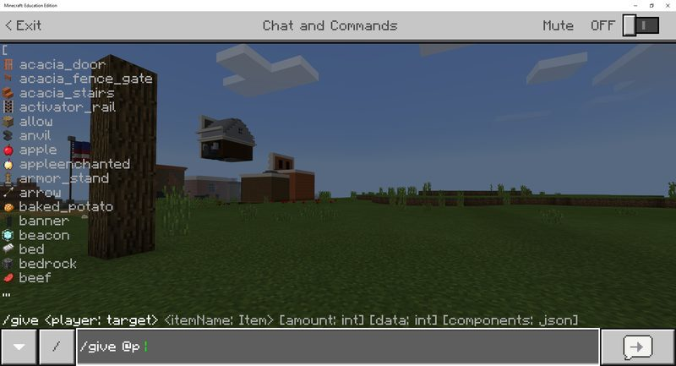
Chicken Storm
Spawn chickens
Name your variable
Make it rain chickens

Slide 7
Review
What did your variable determine in the game?
Why is it good coding practice to give variables meaningful names?

Slide 8
LESSON A What we learned today
Real-life variables
The different kind of coding variables
The importance of variables in coding and Minecraft

Slide 9
Next time
Coding with variables
Learn to use variables in Minecraft to:
Count things in Minecraft
Write a message in the sky
Create a report of your game’s activities

Slide 10
LESSON B: Coding with Variables

Slide 11
What we’ll learn
To code variables in Minecraft to:
Count things
Keep score
Create a report of your game’s activities

Slide 12
Arrow Counter
Learn to count the number of times something happens in your Minecraft world
Create a way to see the value of your variables
Make a message with arrows

Slide 13
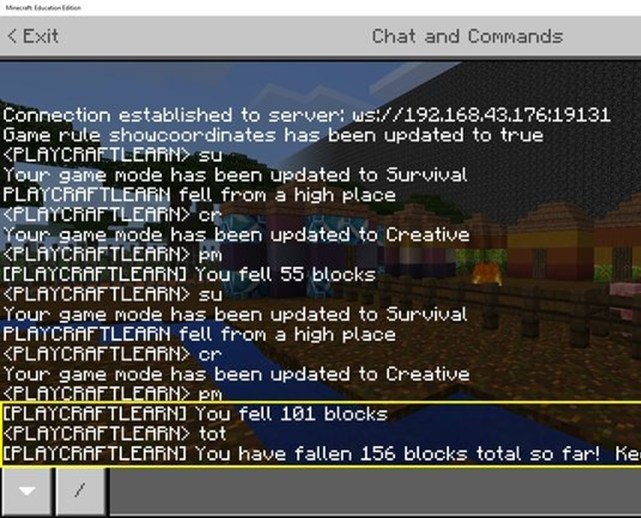
Falls in the air
Create a variable that tracks the distance you have fallen
Use an event handler and a counter to come up with a postmortem report
Make the variable a message

Slide 14
review
How do you use variables to keep score?
How can you cause something to happen when a counter gets to a certain number?
What are variables that hold text called?

Slide 15
LESSON B What we learned today
To use variables in Minecraft to:
Count things
Keep score
Create a report of your game’s activities

Slide 16
Next time
Combining variables to create messages in the sky
Unit 4 quiz

Slide 17
LESSON C : Combining Variables

Slide 18
What we’ll learn
Combining variables to create messages in the sky
Check our learning progress with a quiz

Slide 19
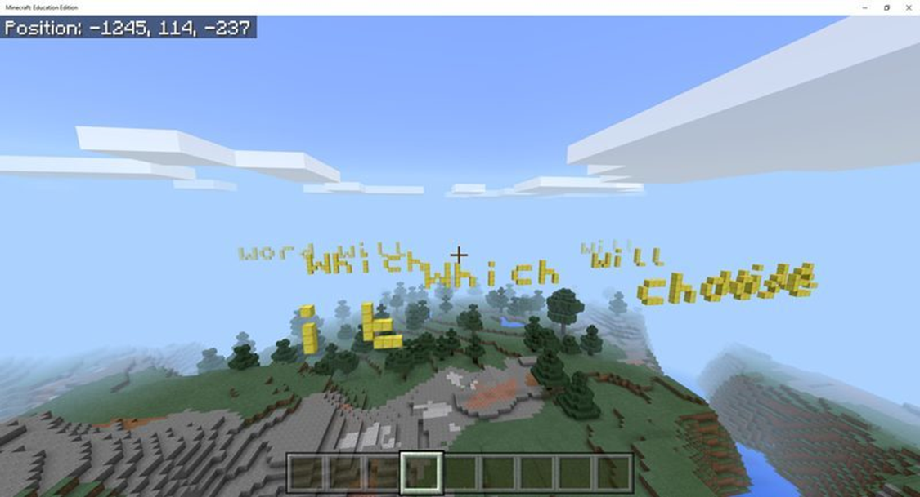
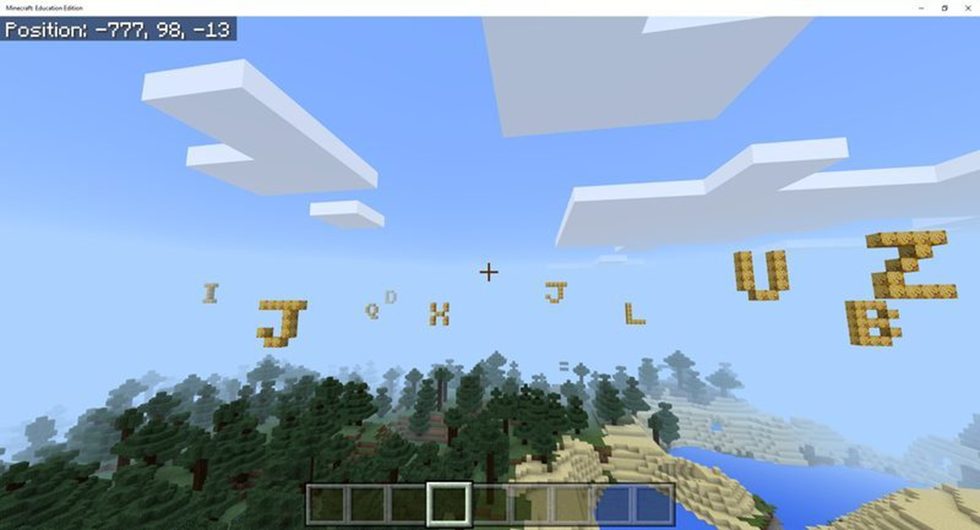
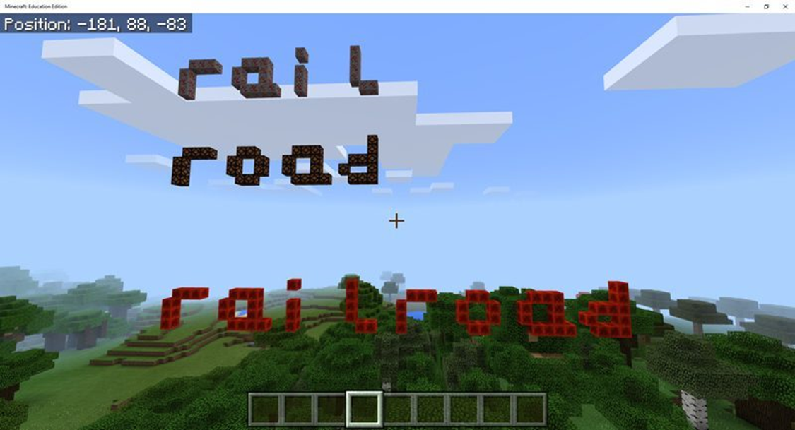
Wordsmith
Create a variable that stands for a word
Combine the variables to create chains of words
Make your own unique situations

Slide 20
LESSON C What we learned today
To combine variables to create messages in the sky
How much we have already learned

Slide 21
Next time
Your independent project

Slide 22
LESSON D: Get Creative with Variables

Slide 23
What we’ll learn
To create your own MakeCode projects that use variables to activate different parts of your program

Slide 24
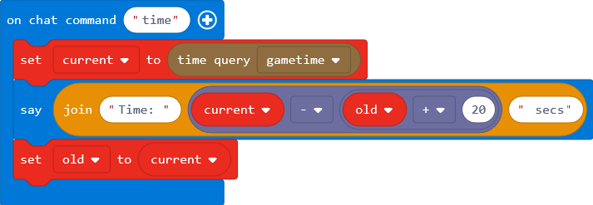
Independent Project
For this project, create an original MakeCode project that uses multiple variables of at least two different types, to keep track of information in Minecraft. Also, find a way to use a chat command with a parameter.

Slide 25
Independent Project
Information you might store in variables / project ideas:
Store the number of something you spawn
Store text for the animal you spawned
Store your position
Store a relative position
Store words to put together to make sentences.

Slide 26
Minecraft Diary entry
What type of information did you choose to keep track of?
What problems did you encounter? How did you solve them?
How did you use variables in your project, and what were their types?
What did you name your variables and why?
What was something new that you learned for this project? Describe how you figured it out.
Include at least one screenshot of your project.

Slide 27
LESSON D What we learned today
To create your own MakeCode projects that use variables

Slide 28
Next time
Coding with Minecraft 5: Conditionals
Then
IF…

